Slide 1
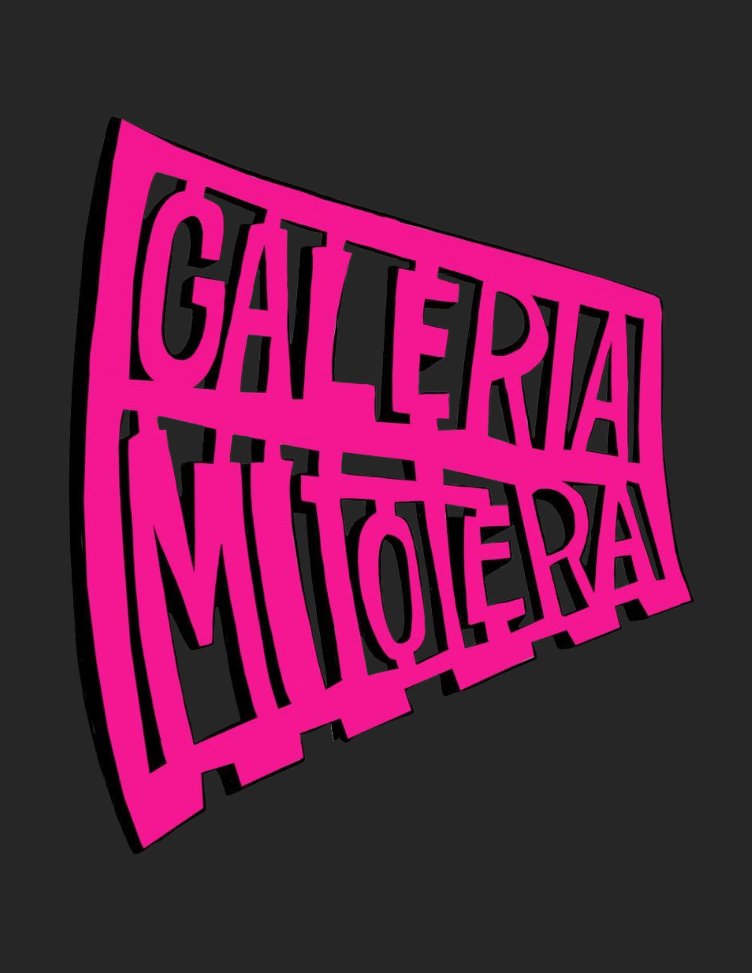
Arte, Cultura Y Frontera Welcome to our Show & Tell!

Slide 2
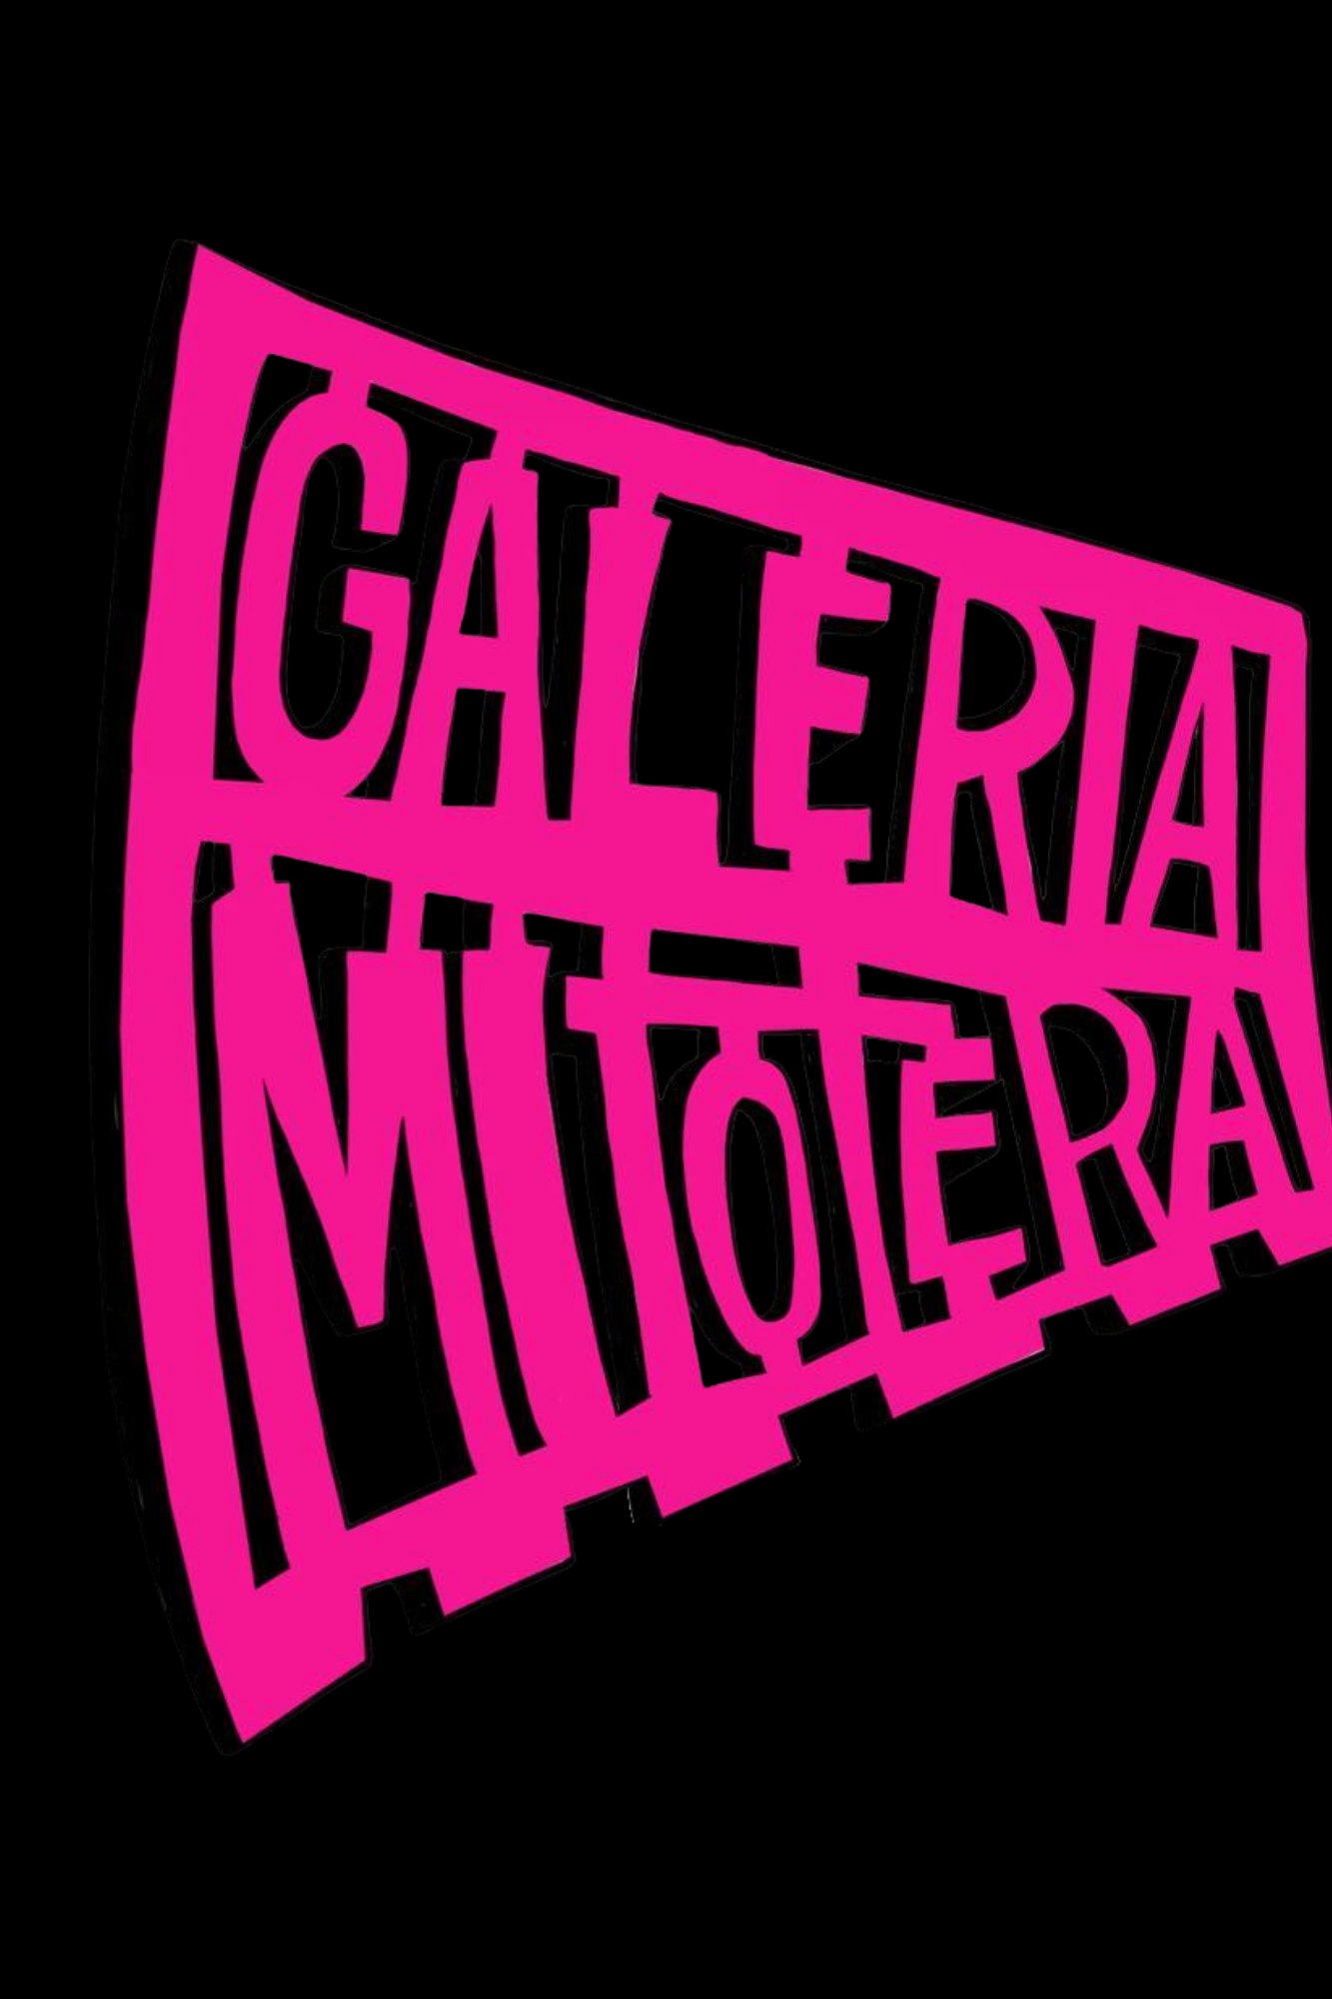
About Galeria Mitotera
Galeria Mitotera is a space to celebrate our Chicanx culture, uplift artists of color in the community and create a safe space for community members and artists to inspire one another through art and togetherness.
Visit us at www.galeriamitotera.com

Slide 3
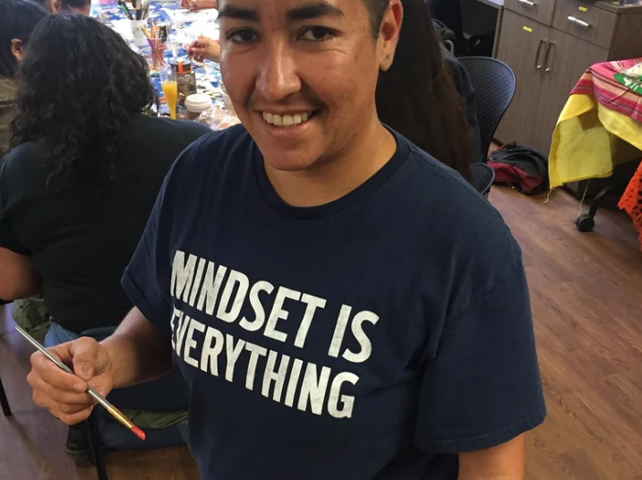
About Galeria Mitotera
Mel “Melo” Dominguez is an artist, muralist from Los Angeles who has lived in Tucson since 2007. Mel’s artwork is a direct expression of his Chicano/a culture, political issues, social issues and environmental issues.
Mel enjoys using creativity and activism to create a difference throughout the Tucson community.

Slide 4
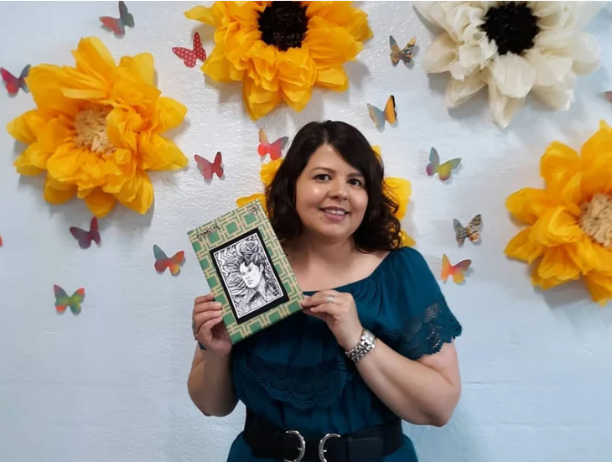
About Galeria Mitotera
Melissa Brown-Dominguez is the arts administrator at Galeria Mitotera who coordinates, manages and supports all of the events and classes with a creative and welcoming spirit.

Slide 5
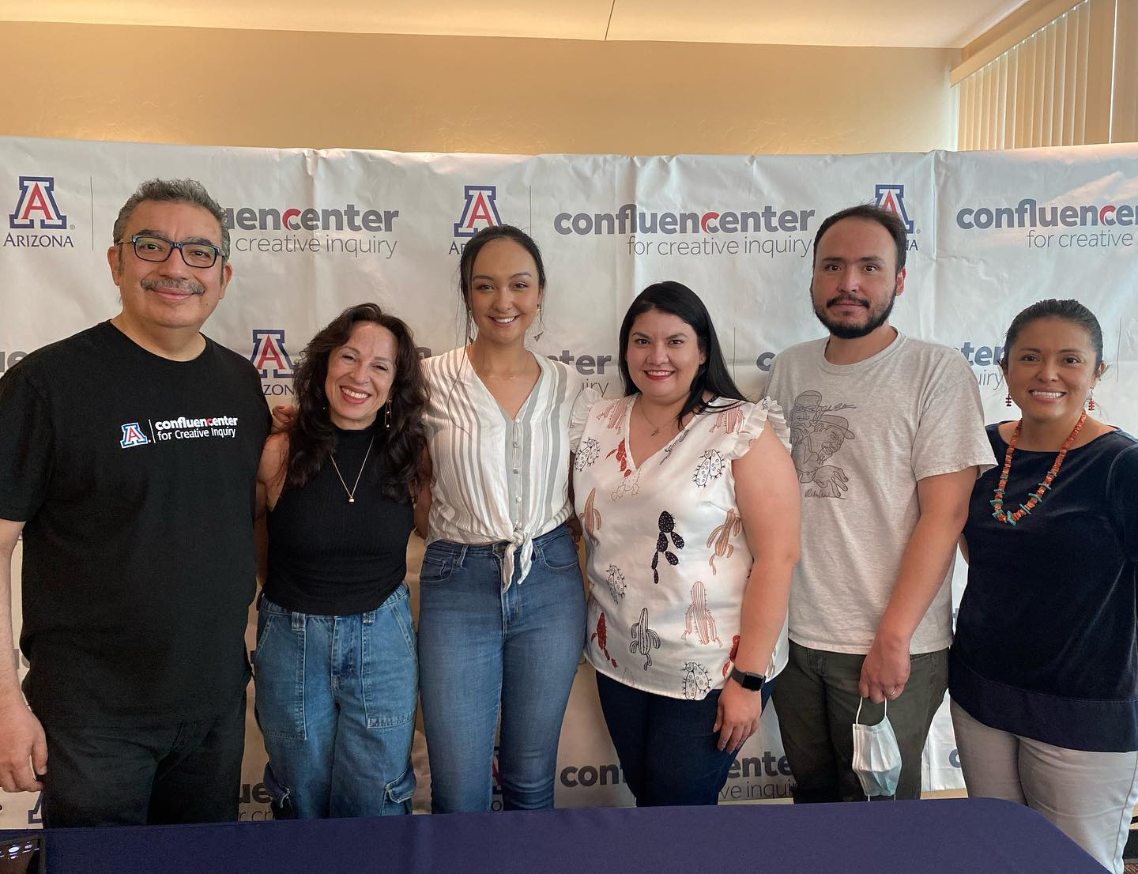
About Confluencenter
Confluencenter for Creative Inquiry is a university-wide research institute within the Office for Research, Innovation, and Impact.
CCI’s mission is to provide a physical and intellectual home for interdisciplinary inquiry that focuses on the grand challenges of society today. The center unites three large and robust areas – arts, humanities, and social sciences – as a point of intersection for inquiry across all disciplines.
The center convenes faculty and students from across disciplines, develops collaborative research projects, funds proposals and shares knowledge in engaging ways with the broader community.

Slide 6
Meet the community artists part of tonight's event…

Slide 7
Ruben Urrea Moreno
Ruben Urrea Moreno is a multi-disciplinary Chicano artist born and raised in South Tucson. His work examines themes of human rights, political plights, and his own indigenous heritage.
A career fabricator, the past five years he's worked as the senior preparator with the Arizona State Museum.
Ruben has work in the permanent collections of the Tucson Museum of Art and El Paso Museum of Art, and Austin Museum of Art and is currently working on a series of portable murals.

Slide 8
Elijah Garcia
Lios enchim aniavu, ketchem allea?
Hello, my name is Elijah Garcia. I am Yaqui, and I am an artist from the Pascua Yaqui Tribe. My area of expertise is in video and editing. I work for my tribe creating media content for our tribal departments.
As the former Cultural Resource Curator for the Pascua Yaqui Tribe Department of Language and Culture, I was surrounded by Yaqui language speakers and my culture on a daily basis. Working for the department, I learned so much about my culture and also learned more about my language.
I also learned that on the UNESCO language chart, the Yaqui language is considered "Severely Endangered". This discovery saddened me. Without our language we will lose so much of our identity! Everything that our ancestors fought and died for will be in vain.
So, as a beginner language speaker, I started to create art that includes simple words and phrases in Yaqui. By doing so, I'm hoping that it will spark a much-needed interest for our people to take the next step and continue our ancestor's legacy one word at a time.
Tua Lios enchim hiokoe utte'esiav

Slide 9
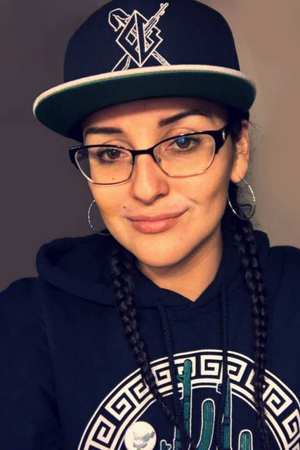
Alaina “Rouge” Peirce
Alaina is a multimedia artist from the village of W:ak on the Tohono O’odham nation & has been local to San Xavier and Tucson the majority of her life.
She specializes in aerosol & digital art, caricatures, and mixed media. She works to create imagery which connects individuals with their culture, specifically by focusing on themes which resonate with people of color, indigenous individuals and youth.
She works to incorporate traditional & modern aesthetics with a goal of strengthening connections between the individual & community.

Slide 10
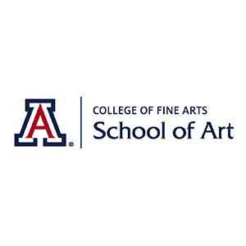
Featuring work from UA Assistant Professor of art, Alejandro Macias

Slide 11
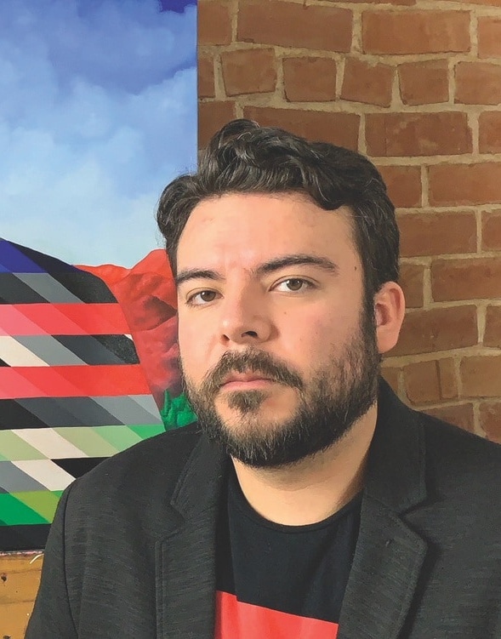
Alejandro Macias
Born and raised in Brownsville, Texas, along the U.S./ Mexico border, Alejandro Macias received a Bachelor of Arts from the University of Texas at Brownsville in 2008, and a Master of Fine Arts in 2-D Studio Art from the University of Texas – Pan American in 2012.
His work has been driven by his Mexican-American identity and the current social-political climate. Raised in the Rio Grande Valley (RGV), his body of work addresses themes of heritage, immigration and ethnicity, which are set in contrast to his critical engagement with the assimilation and acculturation process often referred to as “Americanization.”
He has exhibited nationally and internationally. Since 2016 he has been the recipient of numerous awards and recognitions including notable and prestigious residencies at Centrum in Port Townsend, WA, Vermont Studio Center, Chateau d’Orquevaux in Orquevaux, France, The Studios at MASS MoCA, and most recently Wassaic Project.
His work has been recognized and remains in the permanent collections of The City of San Antonio Department of Art and Culture, Brownsville Museum of Fine Art, Mexic-Arte Museum in Austin, 4Culture in Seattle, WA, Chateau d'Orquevaux, and Tucson Museum of Art.

Slide 12
American
Instagram: @ alex.macias.art
Website: alexmaciasart.com

Slide 13
American II
Instagram: @ alex.macias.art
Website: alexmaciasart.com

Slide 14
Conceal
Instagram: @ alex.macias.art
Website: alexmaciasart.com

Slide 15
Five Minutes of Solace
Instagram: @ alex.macias.art
Website: alexmaciasart.com

Slide 16
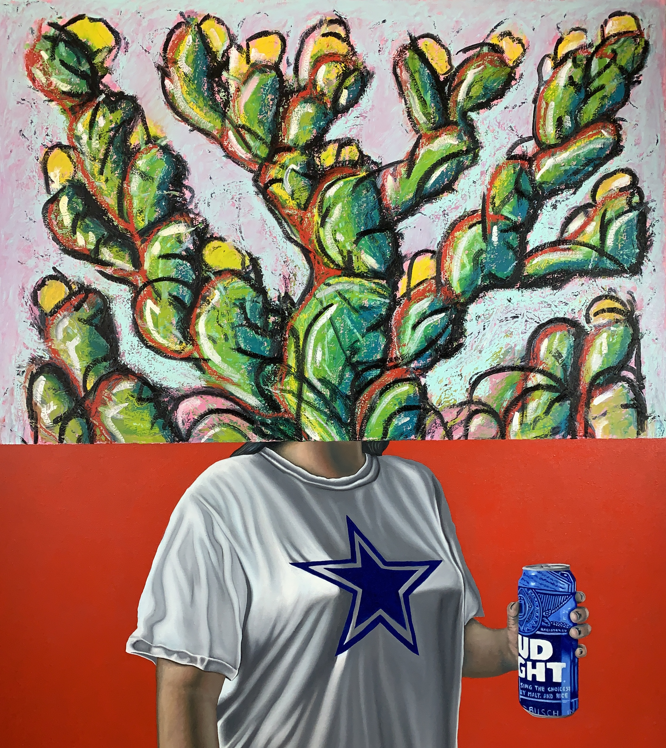
Nopal en la Frente
(con Bud Light)
Instagram: @ alex.macias.art
Website: alexmaciasart.com

Slide 17
Nopal en la Frente (con Dos Equis)
Instagram: @ alex.macias.art
Website: alexmaciasart.com

Slide 18
I Traded a River for Mountains (Departure & Arrival)
Instagram: @ alex.macias.art
Website: alexmaciasart.com

Slide 19
Vanished
Instagram: @ alex.macias.art
Website: alexmaciasart.com

